Slide 1


Headquarter Compliance
Presented by AgSafe
Notes:
Hello in this session we will tackle the paperwork requirements that come along with using pesticides and specifically having to do with headquarter compliance.

Slide 2
Disclaimer
The AgSafe Board of Directors reserves the right to impose limitations on the participation of members, member's employees, sponsors, or participants during any AgSafe session as the result of conduct or the manner or mode of participation which is unlawful, offensive, objectionable or contrary to AgSafe's mission or values. Such limitations can include but are not limited to rejection or ejection of a member, member's employee, participant, sponsor or guest or other reasonable methods that are consistent with this policy including refusal of participation where deemed in the best interest of AgSafe or its members or guests.

Slide 3
Disclaimer (continued)
Failure to comply with all written and verbal instructions provided by AgSafe staff, volunteers and/or representatives before, during or after the webinar may result in action by AgSafe, including but not limited to non-issuance of participant registration fee refunds or non-issuance of certificates of participation.
The content of this session is based on publicly available information. Such information is subject to change without notice, may be incomplete or condensed. Except where otherwise indicated, the information provided is based on matters as they exist as of the date of presentation. Such information is provided as general information on the topics presented. Nothing presented today constitutes legal advice or opinion to participants or others attending or reviewing this material and is not a substitute for professional services. Every situation is different and subject to legislative activity and administrative or judicial changes in the law. You should also note that the views or opinions expressed by the presenters do not necessarily reflect the views or opinions of AgSafe.
Notes:
Here is the second half of the disclaimer.

Slide 4



Learning Objectives
Review the elements that an inspector looks for while conducting a pesticide headquarter inspection
Provide practical solutions to compliance requirements while keeping handlers safe
Notes:
We will review the elements that an inspector will look for while conducting a pesticide headquarter inspection and provide some practical solutions to keep you in compliance and your employees safe.

Slide 5
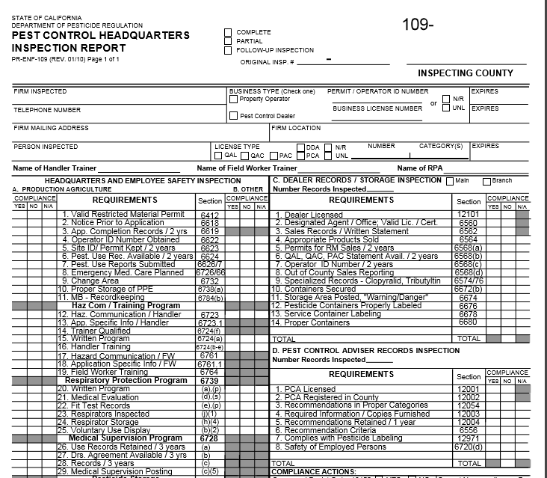
What will an inspector look for?
Notes:
A headquarter inspection is different than an application inspection. Typically an application inspection is unplanned, the county inspector sees someone spraying and then stops. Most of the time a headquarter inspection is scheduled and you and the inspector decide on a meeting date and time. Headquarter inspections can be random, or sometimes they are a result of a violation that occurred during an application inspection. The form that I show here is the form the county inspector will use … they may have it in paper form or on a computer program. But, the elements of compliance are the same. I have included the link where you can access this form on the department of pesticide regulation's website. After this webinar, you may want to do a mock audit on your own program, AgSafe also offers this service.

Slide 6
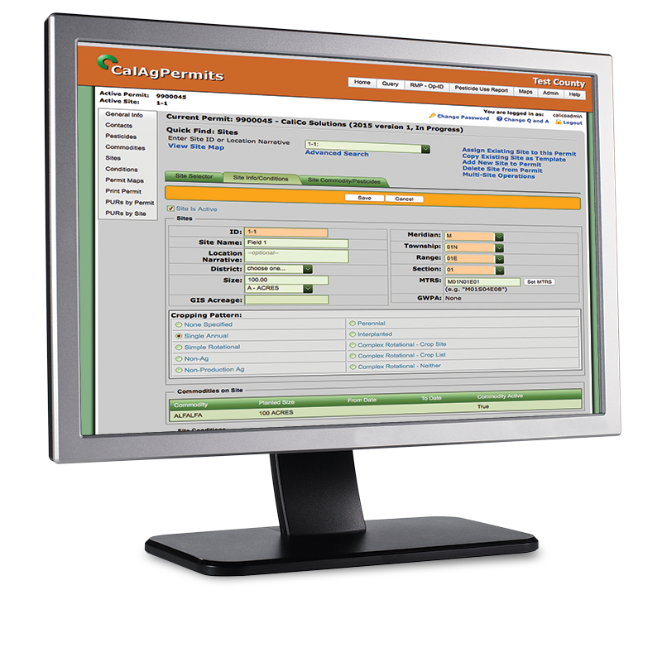


Valid Restricted Materials Permit
3CCR 6412 (Add some bullets with information)
Notes:
The first element listed on the form is, do you have a valid permit to use and store pesticides? If you are spraying agricultural pesticides, a permit is required. The type of permit you need is dependent upon the types of pesticides that you are using.
If you do not need restricted materials, like 2,4-d or aluminum phosphide, you need an operator ID. If you need restricted materials, but you will only hire a licensed and registered pest control business, then you may want a “pest control business use only” permit. This type of permit allows you to spray non-restricted materials like round-up and hire a PCB to apply the restricted materials. If you or an employee of yours plans to do the applying of restricted materials then you need an restricted materials permit.
Prior to obtaining this type of permit you need to be certified. You can either obtain a private applicator card PAC, the salmon colored card shown here, or a qualified applicator certificate QAC or qualified applicator license QAL. Most of the time a private application card will suffice, if you do not plan on doing pest control work for hire. You can take the test for a PAC at you local agricultural commissioner’s office. To obtain your QAC or QAL you must test through the dept of pesticide regulation.
(a) Except as provided in this Section and Sections 6400, 6414 and 6416, restricted materials shall be possessed or used only under permit of the commissioner or under his direct supervision, or under permit of the director in any county in which there is no commissioner.
(b) The person named in a restricted material permit is authorized to retain possession, except for sale, of materials for which the permit was valid after such permit expires, provided they are stored in accordance with Sections 6670 and 6672.

Slide 7
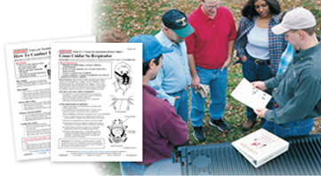
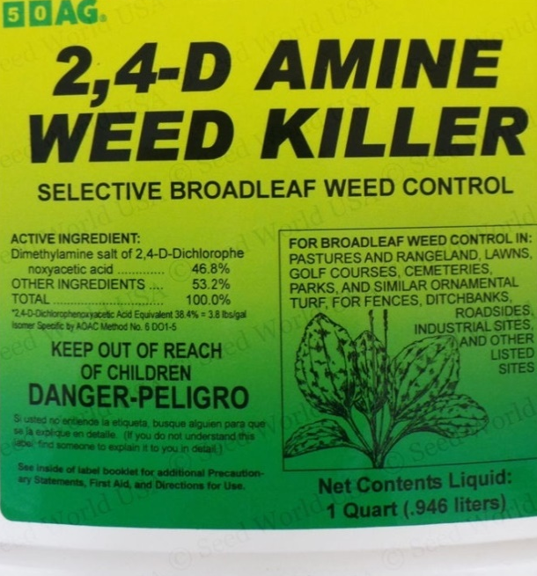
Notice Prior to Application
3CCR 6618
8/20/2022
Field 10
2, 4-D Amine
EPA Reg #
Active Ingredient
Spray adjuvants
REI
Notes:
Next is notice prior to application. Any person performing pest control work must make sure that the operator of the property receives notice of the scheduled application. The notice must be made prior to the use of a pesticide and in enough time for the persons notified to take appropriate action. A notice of completion is also required for applications made for the production of an agricultural commodity.
An example of this, if you are the grower and hire a pest control business to do the spraying, the pest control business must let the grower know when they plan on doing the application, so that the grower can then inform any employees or fieldworker that may walk within a ¼ mile of the field that will receive spraying.
You need to have some type of system in place that so that you can not only answers the inspectors questions, but more importantly you don’t want anyone to mistakenly enter a treated field.
So how you do you accomplish this? What I found while I was inspecting was growers would start their day with a quick tailgate meeting informing everyone if a field have been sprayed or if any fields are planned to be sprayed that day. This way you and your employees can schedule work in areas away from the pesticide application.
You need to make your employees aware of:
The date of the scheduled application;
The location and description of the field to be treated;
The pesticide product name(s), U.S. EPA registration number(s), and active ingredient(s);
Spray adjuvant product name(s) and California registration number(s), if applicable;
The applicable restricted entry interval;
If the pesticide product labeling requires the posting of treated fields-and
Any other precautions printed on the pesticide product labeling, or included in applicable laws and regulations, related to the protection of employees or other persons during or after application.
Remember to check in with the PCB, they are required to let you know of their completion time so that you can observe the correct re-entry interval time period. We will discuss this more on the next slide.
(a) This subsection applies to the use of any pesticide for the commercial or research production of an agricultural plant commodity. Notifications required by this subsection must be given orally or in writing and completed prior to the use of any pesticide and in ample time for all subsequent notifications to be made and for all persons notified to take appropriate action. This time will differ depending on the circumstances of each notification.
(1) Each person performing pest control shall assure that the operator of the property to be treated receives notice of the scheduled application. The notice must be in a manner the person can understand and include:
(A) The date of the scheduled application;
(B) The location and description of the field to be treated;
(C) The pesticide product name(s), U.S. EPA registration number(s), and active ingredient(s);
(D) Spray adjuvant product name(s) and California registration number(s), if applicable;
(E) The applicable restricted entry interval;
(F) If the pesticide product labeling requires the posting of treated fields-and
(G) Any other precautions printed on the pesticide product labeling, or included in applicable laws and regulations, related to the protection of employees or other persons during or after application.
(2) If there is a change in the date of the scheduled application specified in (a)(1)(A), each person performing pest control shall assure that the operator of the property receives notice of this change prior to the application.
(3) The operator of the property shall assure that notice of the scheduled application is given to employees covered under section 6700 (which includes fieldworkers) and their employers working on the operator’s property except as provided in (a)(5). The operator of the property is not required to provide notice to persons who will apply the pesticide(s) or supervise the application for which the notice is intended.
(4) Any employer notified of a scheduled application by the operator of the property shall assure that notice of the scheduled application is given to his or her employees working on the operator’s property except as provided in (a)(5).
(5) The notice specified in subsections (a)(3) and (4) is not required to be given to an employee covered under section 6700 (which includes fieldworkers) or their employer if the operator of the property can assure that:
(A) The field to be treated is posted pursuant to section 6776(b-f), unless the pesticide product labeling requires both oral notification and the posting of treated fields; or
(B) From the start of the application and until the notice of completion pursuant to section 6619(c) is received, the employee or employer will not enter or walk within ¼ mile of the field to be treated.
(6) The operator of the property shall assure that notice is given to persons, other than those specified in subsection (a)(3), whom the operator of the property has prior knowledge that he or she will likely enter the field to be treated on the date of the application or while the restricted entry interval is in effect. This notice is not required when a field to be treated is posted as specified in section 6776(b-f).
(7) The notices specified in subsection (a)(3), (4), and (6) must be in a manner the person can understand and include:
(A) The date of the scheduled application;
(B) The location and description of the field to be treated: and
(C) Instructions not to enter the field to be treated until authorized by the operator of the property.
(8) If there is a change in the date of the scheduled application specified in (a)(7)(A), then a new notice must be provided to persons specified in (a)(3), (4), and (6) prior to the application.
(b) This subsection applies to the use of any pesticide for purposes other than the commercial or research production of an agricultural plant commodity. Notifications required by this subsection must be given orally or in writing and be completed prior to the use of any pesticide and in ample time for all subsequent notifications to be made and for all persons notified to take appropriate action. This time will differ depending on the circumstances of each notification.
(1) Each person performing pest control shall assure that the operator of the property receives notice of the scheduled application. The notice must be in a manner the person can understand and include:
(A) The date of the scheduled application;
(B) The identity of the pesticide (including spray adjuvants, if applicable) by brand or common chemical name; and
(C) Any other precautions printed on the pesticide product labeling or included in applicable laws or regulations related to the protection of employees or other persons during the application.
(2) The operator of property shall assure that notice is given to all persons who are on the property to be treated, or who may enter during the application or the period of time that any restrictions on entry are in effect, except for the persons who made or supervised the application for which the notice is intended. The notice must be in a manner the person can understand and include:
(A) The date of the scheduled application;
(B) The identity of the pesticide (including spray adjuvants, if applicable) by brand or common chemical name; and
(C) Precautions to be observed as printed on the pesticide product labeling or included in applicable laws or regulations related to the entry of the treated area.
(3) Compliance by licensed Structural Pest Control Operators with the notice requirements of Section 8538 of the Business and Professions Code meets the requirements of this subsection.
(4) Compliance by public agencies with the notice or barrier requirements of Section 12978 of the Food and Agricultural Code meets the notice requirements of this subsection.

Slide 8


Application Completion Records
3CCR 6619
Notice must include:
1. Location of property, site id #, and acreage treated;
2. Pesticide product name(s), US EPA reg #(s) and active ingredient(s);
3. Spray adjuvant product name(s) and Ca registration #(s), if applicable;
4. The date and hour the application was completed; and
5. The applicable reentry and pre-harvest intervals unless a copy of a written recommendation for the subject application made by a licensed agricultural pest control adviser, properly completed, was given to the operator of the property treated.
Notes:
Any person applying pesticides for the production of an agricultural commodity must assure that the operator of the property receives notice of the scheduled application. The notice must be made within 24 hours of the completion of an application.
The notice must include:
(1) The location of the property, including the site identification number, and acreage treated;
(2) The pesticide product name(s), U.S. EPA registration number(s) and active ingredient(s);
(3) Spray adjuvant product name(s) and California registration number(s), if applicable;
(4) The date and hour the application was completed; and
(5) The applicable reentry and pre-harvest intervals, unless a copy of a written recommendation for the subject application made by a licensed agricultural pest control adviser, properly completed, was given to the operator of the property treated.
If you have a hired a PCB, they are required to notify you of the application completion time so you can then make your employees aware of the REI, restricted entry interval.
The REI is the period of time after a field is treated with a pesticide during which restrictions on entry are in effect to protect persons from potential exposure to hazardous levels of pesticide residues.
The operator of the property and any PCB, farm labor contractor or other contractor hired by the operator of the property that have employees who are likely to enter a field while the REI is in effect must notify those employees. Handler and fieldworker employees who may walk within ¼ mile of a field during a REI are deemed in regulation as likely to enter.
You must keep record of this for 2 years.
Again communication with your employees in regards to pesticide use is key.
(a) Any person applying pesticides for the commercial or research production of an agricultural plant commodity shall assure that the operator of the property treated receives notice, orally or in writing, and within 24 hours of completion of the pesticide application. This notice must include the following information:
(1) The location of the property, including the site identification number, and acreage treated;
(2) The pesticide product name(s), U.S. EPA registration number(s) and active ingredient(s);
(3) Spray adjuvant product name(s) and California registration number(s), if applicable;
(4) The date and hour the application was completed; and
(5) The applicable reentry and pre-harvest intervals, unless a copy of a written recommendation for the subject application made by a licensed agricultural pest control adviser, properly completed, was given to the operator of the property treated.
(b) The operator of the property treated shall maintain a written record of the application completion notice(s) he or she receives from the person applying the pesticide(s) by site.
(c) The operator of the property shall assure that notice of completed application is given to employees covered under section 6700 (which includes fieldworkers) and their employers except as provided in (e) .The operator of the property is not required to provide notice to persons who will apply the pesticide(s) or supervise the application for which the notice is intended.
(d) Any employer who receives the notice of completed application from the operator of the property shall assure that notice of completed application is given to his or her employees except as provided in (e).
(e) The notices specified in subsections (c) and (d) are not required to be given to an employee covered under section 6700 (which includes fieldworkers) or their employer if the operator of the property can assure that:
(1) The field is posted pursuant to section 6776(b-f), unless the pesticide product labeling requires both oral notification and posting of treated fields; or
(2) During the restricted entry interval, that employee or employer will not enter or walk within ¼ mile of the treated field.
(f) The notices specified in subsections (c) and (d) must be given orally or in writing and in a manner the person can understand and include:
(1) The location and description of the treated field;
(2) The time during which entry is restricted; and
(3) Instructions not to enter the treated field until the restricted entry interval has expired, except as provided in section 6770.
(g) The operator of the property shall assure that notice is given orally or in writing to persons, other than those specified in subsection (c), whom the operator of the property has prior knowledge that he or she will likely enter the treated field during the restricted entry interval. This notice is not required when a field is posted as specified in section 6776(b-f). The notice must be in a manner the person can understand and include:
(1) The location and description of the treated field;
(2) The time during which entry is restricted; and
(3) Instructions not to enter the treated field until the restricted entry interval has expired.
(h) A pest control business shall maintain a written record that documents the following:
(1) The name of the operator of the property treated;
(2) The location of the property, including the site identification number;
(3) The date and time the notice of completed application was given; and
(4) The method of notification, including the name of the person notified, if a person was notified.
(i) The records required pursuant to this Section must be retained for two years and made promptly available to the director or commissioner upon request.

Slide 9

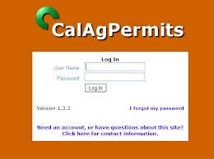
Operator ID Number Obtained
3CCR 6622
Notes:
If you are using registered pesticides for an agricultural use, you must first obtain an operator id number with the agricultural commissioner's office. If you have a restricted materials permit, because you need to use restricted materials, you meet this requirement.
Just be sure you have done this prior to spraying. Remember your permit usually has an expiration date of Dec. 31st. If you have not renewed you permit for the following year you cannot legally spray on Jan 1.
(a) A person performing pest control for hire is exempt from the requirements of this section.
(b) This subsection applies to the production of an agricultural commodity. Prior to the purchase and use of pesticide(s) for the production of an agricultural commodity, the operator of the property (or the operator's authorized representative) shall obtain an operator identification number from the commissioner of each county where pest control work will be performed. The operator shall provide each pest control business applying pesticides to such property with his or her operator identification number.
(c) This subsection applies to the pesticides listed below, when they are not used for the production of an agricultural commodity (e.g., uses on cemeteries, golf courses, parks, right-of-way, post-harvest agricultural commodities, and certain nonagricultural sites). Prior to the purchase and use of pesticides listed below, each operator of the property (or the operator's authorized representative), shall obtain an operator identification number from the commissioner of each county in which the operator intends to perform pest control. The operator of the property is not required to obtain an operator identification number when a person performing pest control for hire purchases and applies these pesticides.
(1) Any pesticide for agricultural use, as defined in Food and Agricultural Code section 11408, excluding those for use only on livestock, as defined in Food and Agricultural Code section 18663;
(2) Any pesticide listed in section 6400;
(3) Any pesticide for industrial use as a post-harvest commodity treatment; and
(4) Any pesticide listed in section 6800(b) for any outdoor institutional or outdoor industrial use.
(d) This subsection applies to both subsection (b) and (c).
(1) Each operator of the property to be treated who is required to obtain a number shall provide the commissioner with a list of the counties in which pest control will be performed and all valid operator identification number(s) issued by other commissioners. The number(s) provided by the operator of the property shall be recorded by the commissioner on the operator's restricted materials permit or on a form approved by the director.
(2) The operator of the property to be treated shall be issued an operator identification number from the commissioner of each county in which the operator intends to perform pest control. The number shall be recorded on a restricted materials permit, if the operator of the property has such a permit, or issued on a form approved by the director, and shall be valid for a specified period not to exceed 36 months.
(3) The requirements of this section do not exempt an operator of the property to be treated from obtaining a restricted materials permit(s) or a qualified applicator certificate.

Slide 10
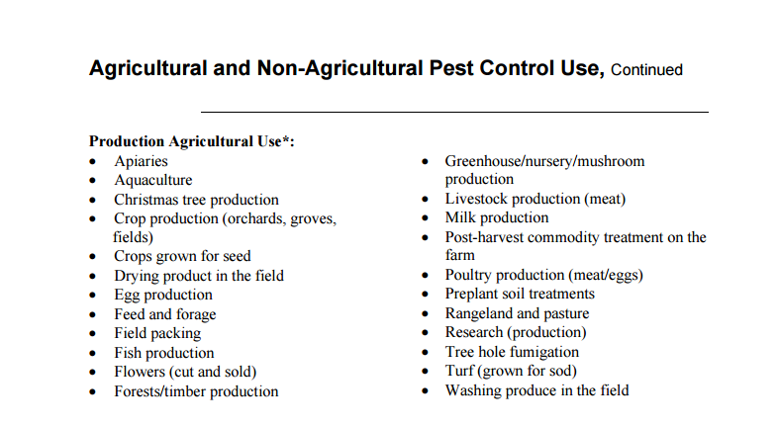
What is Ag Use?
Notes:
I have mentioned production Ag Use a couple of times. In this slide I have shared a copy of what DPR deems ag use. The link to the actual document is shown on the bottom of the slide.
Notice this list isn't just orchards and field crops, it include apiaries, tree hole fumigation, and even Christmas tree production.

Slide 11

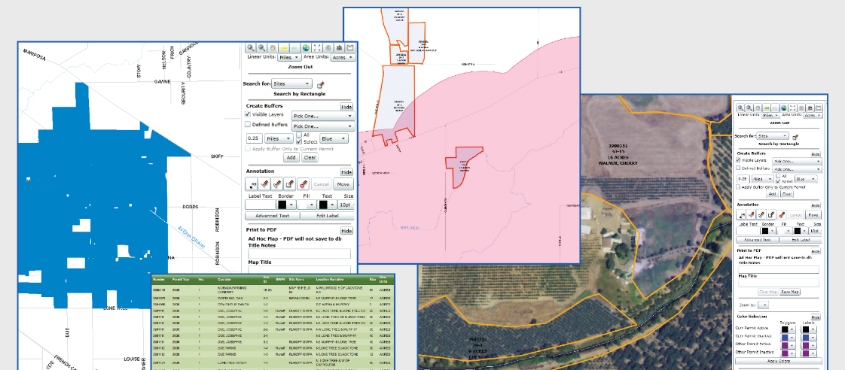
Site ID/Permit Kept/2 Years
3CCR 6623
The permit shall include:
(1) The name and address of the operator of the property;
(2) The operator identification number;
(3) The location, description, or map of the site(s) where the pest control will be performed;
(4) A site identification number for each site where the pest control will be performed; and
(5) The date of issuance of the site identification number(s).
Notes:
Prior to the using any registered pesticide on property that is used for the production of an agricultural commodity, the property operator, you the grower, must obtain a site identification number for each site where pest control will be performed. Each site must be identified on either a restricted materials permit or an operator identification form.
The permit shall include:
(1) The name and address of the operator of the property;
(2) The operator identification number;
(3) The location, description, or map of the site(s) where the pest control will be performed;
(4) A site identification number for each site where the pest control will be performed; and
(5) The date of issuance of the site identification number(s).
A copy of the permit must be kept for 2 years.
Each county name sites differently, some may require you to name your site according to their naming system, like a A1 or 1215A1, while others allow you to use your naming system like Joe’s place. Whichever way, as long as your site is identified on the permit. Be sure that your permit includes all of the location that you plan to spray pesticides on.
(a) Prior to the use of pesticide(s) for the production of an agricultural commodity, the operator of the property shall obtain site identification number(s) from the commissioner for each site where pest control work will be performed. The site identification number(s) shall be valid for the same, concurrent, period of time as the operator identification number.
(b) The site identification number(s) shall be recorded by the commissioner on a restricted materials permit, if the operator of the property has such a permit, or on a form approved by the director. The information on the permit or form shall include:
(1) The name and address of the operator of the property;
(2) The operator identification number;
(3) The location, description, or map of the site(s) where the pest control will be performed;
(4) A site identification number for each site where the pest control will be performed; and
(5) The date of issuance of the site identification number(s).
(c) The operator of the property shall retain a copy of each restricted material permit or form for two years and make them promptly available to the director or commissioner upon request.

Slide 12
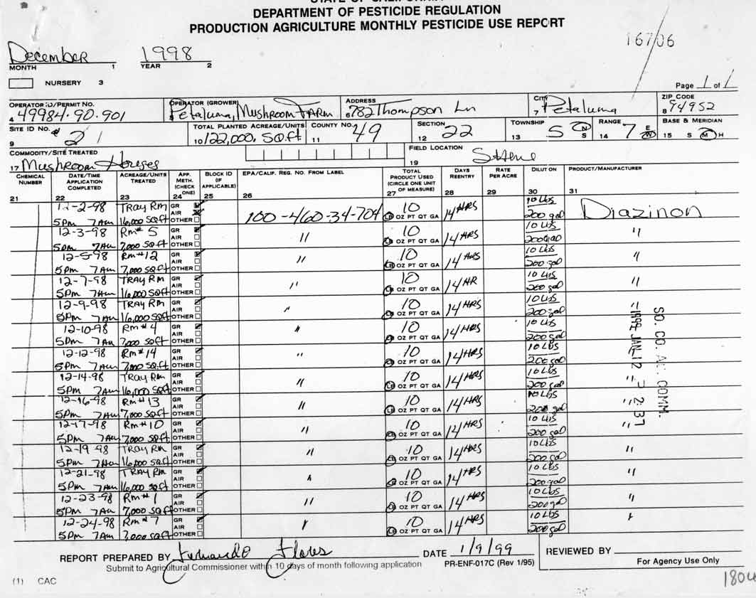

Pest. Use Rec. Available/2 Years
3CCR 6624
Notes:
Any person who uses pesticide for an agricultural use shall record the following information for 2 years:
(1) Date of application;
(2) Name of the operator of the property treated;
(3) Location of property treated;
(4) Crop commodity, or site treated;
(5) Total acreage or units treated at the site; and
(6) Pesticide, including the U.S. Environmental Protection Agency (U.S. EPA) or State registration number which is on the pesticide label, and amount used.
&
(1) Location of the property treated, by county, section, township, range, base and meridian;
(2) Hour the treatment was completed;
(3) The operator identification number issued to the operator of the property treated;
(4) The site identification number issued to the operator of the property treated;
(5) Total acreage (planted) or units at the site; and
(6) Name or identity of the person(s) who made and supervised the application, if the pesticide application was made by an agricultural pest control business.
This requirement is kind of a the chicken before the egg, before you can keep record of pesticide use reports, you should have first submitted them to your local agricultural commissioner’s office. Which happens to be the next requirement.
a) The following persons shall maintain records of pesticide use:
(1) Any person who uses a pesticide for an agricultural use as defined in Food and Agricultural Code section 11408, other than use on livestock as defined in Food and Agricultural Code section 18663;
(2) Any person who uses a pesticide listed in section 6400;
(3) Any person engaged for hire in the business of pest control;
(4) Any person who uses a pesticide for industrial post-harvest commodity treatment; and
(5) Any person who uses a pesticide listed in section 6800(b) for any outdoor institution or outdoor industrial use.
(b) The records shall include the following information for each pest control operation:
(1) Date of application;
(2) Name of the operator of the property treated;
(3) Location of property treated;
(4) Crop commodity, or site treated;
(5) Total acreage or units treated at the site; and
(6) Pesticide, including the U.S. Environmental Protection Agency (U.S. EPA) or State registration number which is on the pesticide label, and amount used.
(c) In addition to the information required in subsection (b), the operator of the property which is producing an agricultural commodity, and an agricultural pest control business applying pesticides to such property, shall include in the records the following information for each pest control operation:
(1) Location of the property treated, by county, section, township, range, base and meridian;
(2) Hour the treatment was completed;
(3) The operator identification number issued to the operator of the property treated;
(4) The site identification number issued to the operator of the property treated;
(5) Total acreage (planted) or units at the site; and
(6) Name or identity of the person(s) who made and supervised the application, if the pesticide application was made by an agricultural pest control business.
(d) The operator of the property which is producing an agricultural commodity shall maintain records of pesticides applied by an agricultural pest control business to such property, by site.
(e) In addition to the information required in (b), effective January 1, 2002, persons engaged for hire in the business of pest control at a school site [defined in Education Code section 17609(e)] shall include in the records the following information for each pest control operation:
(1) Time application was completed;
(2) Name and address of the school site; and
(3) Application location at the school site. For purposes of this subsection, location includes, but is not limited to, classrooms, playgrounds, cafeteria, vehicles, and athletic fields.
(f) In addition to the information required in subsections (b) and (c), persons who use methyl bromide, 1,3-Dichloropropene, chloropicrin, metam-sodium, N-methyl dithiocarbamate (metam-potassium), dazomet, or sodium tetrathiocarbonate field fumigants within the Sacramento Metro, San Joaquin Valley, South Coast, Southeast Desert, or Ventura ozone nonattainment areas shall include in the records a description of the method of application pursuant to sections 6446.1, 6447.3, 6448.1, 6449.1, 6450.1, 6450.2, 6451.1, or 6452.
(g) The records required pursuant to this section shall be retained for two years and made promptly available to the director or commissioner upon request.

Slide 13
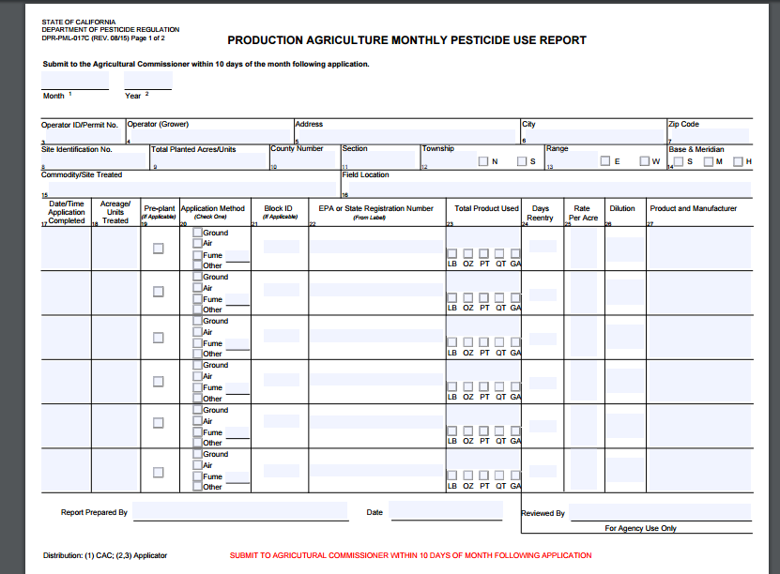
Pest. Use Reports Submitted
3CCR 6626/7
Notes:
The operator of the property, where the pesticides were applied shall submit the pesticide use report to the agricultural commissioner’s office by the 10th day of the following month in which the pesticides were sprayed. If you hired a pest control business to do the spraying, they are required to submit the reports to the ag com office w/in 7 days, and send you the grower a copy w/in 30days.
The form shown here is available on DPR’s website, I have included the link. You do not have to use this specific forms. Most ag comm offices will offer a triplicate form, or you can use electronic form in a system like calagpermits or agrian. Which ever way you choose, be sure and do it. Not only is it the regulations, but most counties check to see if you have submitted this form prior to renewing you permit each year.
Please note the form I have shown here is intended to report production ag use spraying. What if you just applied pesticides to your rights of way area, like a canal bank or a fenceline?
(a) The operator of the property which is producing an agricultural commodity shall report the use of pesticides applied to the crop, commodity, or site to the commissioner of the county in which the pest control was performed. This report must be submitted by the 10th day of the month following the month in which the work was performed. This report is not required if the pesticide use is reported to the commissioner by pest control business as specified in subsection (b); however, the operator of the property treated, shall retain a copy of the business’ “Report by Site” for two years.
(b) An agricultural pest control business shall report the use of pesticides applied by it for the production of an agricultural commodity to the commissioner of the county in which the pest control was performed. This report must be submitted within seven days of completion of the pesticide application. A copy of the report shall be sent by the business to the operator of the property where the pest control was done within 30 days of completion of the pesticide application.
(c) Each report of pesticide use pursuant to this Section shall be on a department form or in a format approved by the director. Acceptable department forms include form 38-017 for an operator of the property to report pursuant to subsection (a), and 39-025 for an agricultural pest control business to report pursuant to subsection (b). The information to be reported shall include the information specified in Section 6624, and the name and address of the agricultural pest control business which made the application, if such a business made the application.
(d) A use report required by (a) or (b) for the application of a field soil fumigants in the Sacramento Metro, San Joaquin Valley, South Coast, Southeast Desert, and Ventura ozone nonattainment areas shall include the information specified in 6624(f) in addition to that required by this section.
(e) If the report is mailed, the postmark shall be the date of delivery.
(f) If the county in which work was performed has no commissioner, the report shall be made to the director.
(a) Except as provided in section 6626, persons required to maintain pesticide use records pursuant to section 6624 shall report a summary of the monthly use of pesticides to the commissioner of the county in which the work was performed. The report shall be provided to the commissioner by the 10th day of the month following the month in which the work was performed. If the report is mailed, the postmark shall be the date of delivery.
(b) The report shall be in a format approved by the director. The report shall include the following:
(1) The name and address of the person who or business/organization which applied the pesticide(s);
(2) County where the pest control was performed;
(3) Month and year of pesticide use;
(4) Crop, commodity or site treated, except when using a designated use code, as specified on the Monthly Summary Pesticide Use Report form;
(5) Pesticide, including the United Stated Environmental Protection Agency or State registration number which is on the pesticide label, and the amount used;
(6) Number of applications made with each pesticide and the total number of applications made during the month; and
(7) Total acres or units treated with each pesticide, except when using a designated use code, as specified on Summary Pesticide Use Report form.
(c) If the county in which the work was performed has no commissioner, the report shall be made to the director.

Slide 14
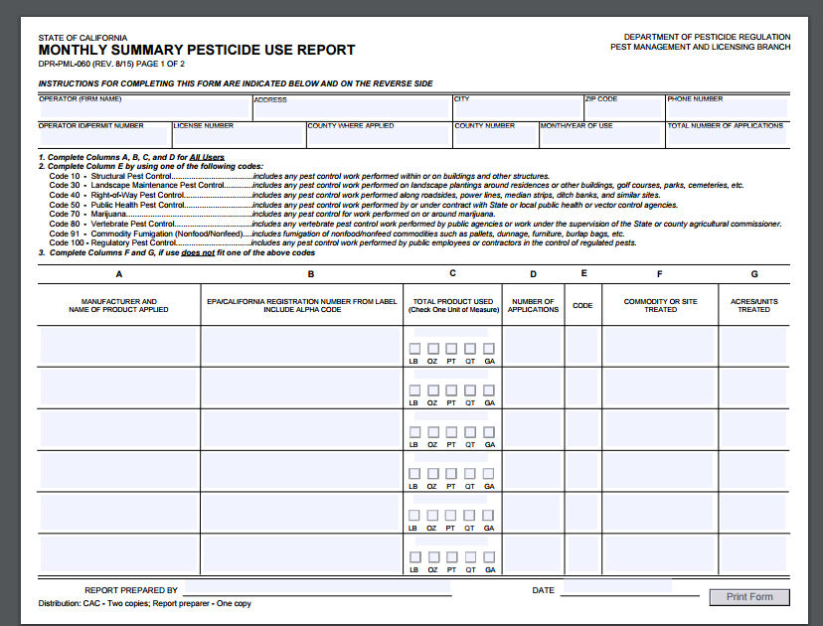
Notes:
In that case you would use this form. This is the monthly summary form. I have boxed in the code 40, which says rights of way. I have included the link to DRPs website to access this form.

Slide 15
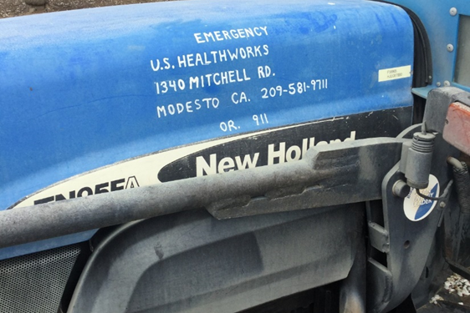
Emergency Medical Care Planned
3CCR 6726/66
Notes:
The grower shall ensure that…
(a) Emergency medical care for employees handling pesticides shall be planned for in advance. The employer shall locate a facility where emergency medical care is available for employees who will be handling pesticides.
(b) Employees shall be informed of the name and location of a facility where emergency medical care is available. The employer shall post in a prominent place at the work site, or work vehicle if there is no designated work site, the name, address and telephone number of a facility able to provide emergency medical care whenever employees will be handling pesticides and, if the identified facility is not reasonably accessible from that work location, procedures to be followed to obtain emergency medical care.
(c) When there is reasonable grounds to suspect that an employee has a pesticide illness, or when an exposure to a pesticide has occurred that might reasonably be expected to lead to an employee’s illness, the employer shall ensure that the employee is taken to a physician immediately.
Be sure that if you suspect any kind of pesticide illness, that you take the employee to the doctor. DO not let them go home or have a family member take them, you are required to take them. This issue came up several times while I was inspecting.
Requirements informatio.
(a) Emergency medical care for employees handling pesticides shall be planned for in advance. The employer shall locate a facility where emergency medical care is available for employees who will be handling pesticides.
(b) Employees shall be informed of the name and location of a facility where emergency medical care is available. The employer shall post in a prominent place at the work site, or work vehicle if there is no designated work site, the name, address and telephone number of a facility able to provide emergency medical care whenever employees will be handling pesticides and, if the identified facility is not reasonably accessible from that work location, procedures to be followed to obtain emergency medical care.
(c) When there is reasonable grounds to suspect that an employee has a pesticide illness, or when an exposure to a pesticide has occurred that might reasonably be expected to lead to an employee’s illness, the employer shall ensure that the employee is taken to a physician immediately.
(a) Emergency medical care for employees who enter fields that have been treated with pesticides shall be planned for in advance. The employer shall locate a facility where emergency care is available for employees who will be working in treated fields.
(b) The employees, or their supervisor in the field, shall be informed of the name and location of a physician or medical facility where emergency medical care is available, and if the identified facility is not reasonably accessible from that work location, the procedures to be followed to obtain emergency medical care.
(c) When there are reasonable grounds to suspect that an employee has a pesticide illness, or when an exposure to a pesticide has occurred that might reasonably be expected to lead to an employee's illness, the employer shall ensure that the employee is taken to a physician immediately.

Slide 16
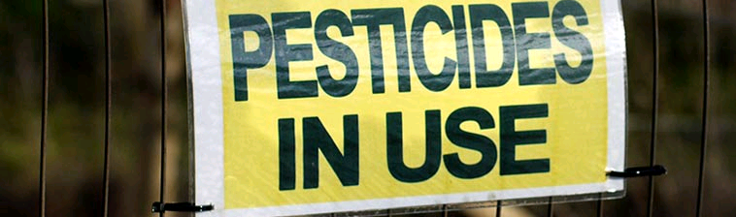



Change Area
3CCR 6732
Notes:
For any employee who regularly handles pesticides with the signal word "DANGER" or "WARNING", and for all employees who handle any pesticides for the commercial or research production of an agricultural plant commodity, the employer shall assure that there is,
at the place where employees end their exposure period and remove their personal protective equipment,
an area where employees may change clothes and wash themselves. Clean towels, soap, and sufficient water shall be available to allow for thorough washing. The employer shall provide a clean, pesticide-free place where employees may store any personal clothing not in use while at work handling pesticides.

Slide 17
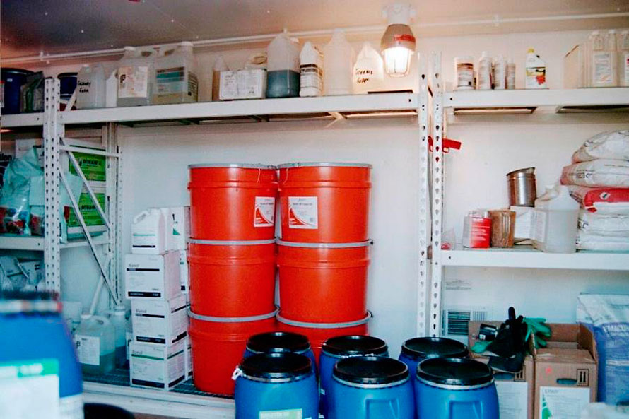
Proper Storage of PPE
3CCR 6738(a)
d
Notes:
(a) The employer shall:
Provide all personal protective equipment required by pesticide product labeling, regulation, and restricted material permit condition, provide for its daily inspection and cleaning (according to pesticide labeling instructions or, absent any instructions, washed in detergent and hot water), and repair or replace any worn, damaged, or heavily contaminated personal protective equipment. Leather gloves used to apply only aluminum phosphide or magnesium phosphide pesticides and which have been aerated for 12 hours or more are considered cleaned.
(2) Assure that all clean personal protective equipment, when not in use, is kept separate from personal clothing and in a clean and pesticide-free, specifically designated place.
(3) Assure that personal protective equipment is used correctly for its intended purpose.
(4) Keep and wash potentially contaminated personal protective equipment separately from other clothing or laundry.
(5) Assure that all clean personal protective equipment is either dried thoroughly before being stored or is put in a well-ventilated place to dry.
(6) Assure that personal protective equipment remains the property of the employer and that pesticide handlers are not allowed or directed to take potentially contaminated personal protective equipment into their homes. However, employees whose work day does not involve return to the employer's headquarters shall remove and store potentially contaminated coveralls in a sealable container outside of their own living quarters for later return to the employer.

Slide 18
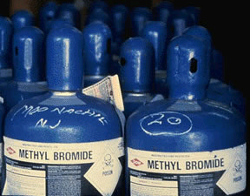

MB – Recordkeeping
3CCR 6784(b)
Notes:
(1) Employer Recordkeeping. The employer shall maintain records for all employees performing fumigation-handling activities. The records must identify the person, work activity(ies), date(s), duration of handling, the U.S. Environmental Protection Agency Registration Number, and the brand name of the methyl bromide product handled. The employer shall maintain these use records at a central location for two years.

Slide 19
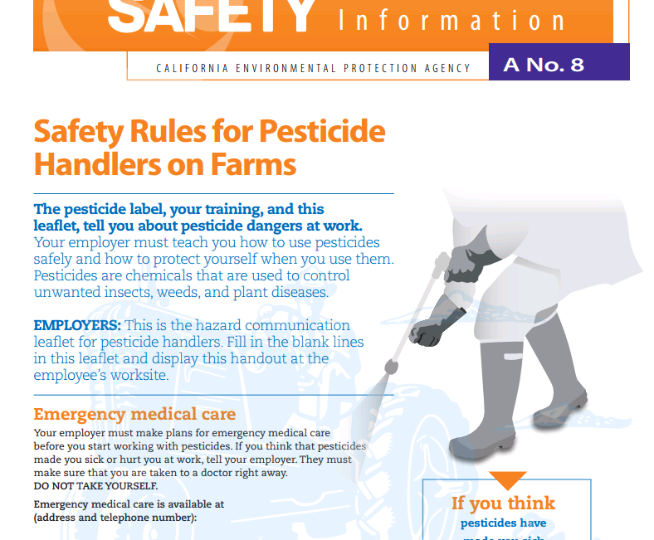

Haz. Communication/Handler/Field Worker Training 3CCR 6723/6761
http://www.cdpr.ca.gov/docs/whs/psisenglish.htm
Notes:
Before employees are allowed to handle pesticides, the employer shall display, in a central location, the A8 for handlers and the A9 for fieldworkers. In a non ag setting you would post the N8, an example of this would be if you were a processor and you fumigated almonds on your property.
I have shared the link here for the entire safety series. DPR has them available in English and Spanish.
You have to do more than post these documents. There are areas where you need to fill in the emergency medical care information and the address and specific location of where employees can find the application specific information. The is a list of what and where pesticides have been sprayed so that employees can be certain they are not working in a treated field. We will talk more about the specific of that in the next slide.
It is important that employees have unimpeded access to this information. As an inspector I would do field worker inspections. According to DPR a field worker is someone who is performing work in a field that has been sprayed in the last 30 days, plus the time of REI. In this case, as an inspector I would look at the A9 to ensure that a location was listed as to where I could find spray information. I would then travel there, if the information was locked up in a shop, the grower would be in violation.
An easy fix, you are required to provide bathrooms, and other types of postings, go ahead and include this information as well. If you have it in a binder, be sure the binder is open to that page and that employees have complete access.
(a) Before employees are allowed to handle pesticides, the employer shall display a copy of a completed written Hazard Communication Information for Employees Handling Pesticides in Agricultural Settings (Pesticide Safety Information Series leaflet A-8) or Hazard Communication Information for Employees Handling Pesticides in Noncrop Settings (Pesticide Safety Information Series leaflet N-8), as applicable, at a central location in the workplace. Upon request, the employer shall read to the requesting employee, in a language understandable to that employee, Pesticide Information Series leaflet A-8/N-8. Pesticide Information Series Leaflet A-8/N-8 shall be written by the Department of Pesticide Regulation in English and Spanish. Pesticide Information Series leaflets are available from the Department.
(b) The employer shall maintain, at a central location at the workplace accessible to employees who handle pesticides, the following:
(1) pesticide use records as specified in section 6624 (b), (c), and (e) for pesticides that have been handled by his or her employees;
(2) copies of available Pesticide Safety Information Series leaflets which are applicable to the pesticides and handling activities listed in the pesticide use records referred to in subsection (b)(1); and
(3) a Safety Data Sheets (SDS), as specified by Title 8 California Code of Regulations, section 5194, for each pesticide listed in the pesticide use records referred to in subsection (b)(1). If the SDS is not provided by the registrant of a pesticide, the employer shall:
(A) within seven working days of a request for a SDS from an employee, employee representative or employee's physician, make written inquiry to the registrant of the pesticide, asking that a SDS be sent to the employer. If the employer has made written inquiry within the last 12 months as to whether the pesticide is subject to the requirement for a SDS or the employer has made a written inquiry within the last 6 months requesting new, revised or later information on the SDS, the employer need not make additional written inquiry. A copy of the written inquiry shall immediately be sent to the person requesting the SDS;
(B) notify the requester of the availability of the SDS or provide a copy of the SDS to the requester within 15 days of receipt of the SDS from the registrant; and
(C) if a response has not been received from the registrant within 25 working days of the date the inquiry was made, send the Department a copy of the inquiry with a notation that no response has been received. The employer is not precluded from obtaining and providing the SDS utilizing other more expedient methods in lieu of those provided in this subsection.
(c) The employer shall inform employees, before they are allowed to handle pesticides and at least annually thereafter, of the location and availability of the records and other documents listed in this section or relating to employee training, monitoring, and potential exposure. If the location of the records and other documents changes, an employer shall promptly inform his or her employees of the new location.
(d) The employer shall provide, upon request of his or her employee, employee representative, or employee's physician, access to any records or other documents required to be maintained pursuant to this chapter. Access shall be granted as soon as possible and not to exceed 48 hours from the date of the request.

Slide 20
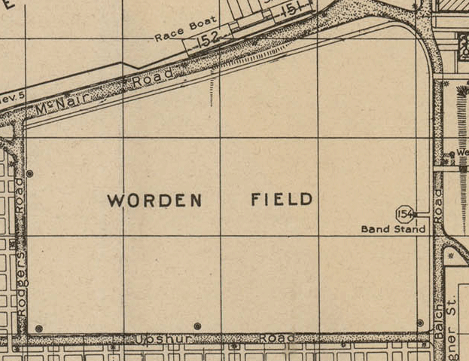
App. Specific Info/Handler & Field Worker - 3CCR 6723.1& 6761.1
Field Number | Date / Time of Application | REI | Pesticide Name | EPA # | Active Ingredients | Spray Adjuvant
Treated Area
Notes:
The application specific information display, ASID, is an important tool in communication with your employees. No to mention it is a regulation.
(a) The operator of property shall display, at a central location, the following application-specific information while employees are employed to handle pesticides:
(1) Identification of the treated area;
(2) Time and date of the application;
(3) Restricted entry interval; and
(4) Product name, EPA registration number, and active ingredients.
(5) Spray adjuvant product name(s) and California registration number(s) if applicable.
The information shall be displayed within 24 hours of the completion of an application and include all applications that have been made to any treated field on the agricultural establishment within 1/4 mile of where employees will be working. Once displayed, the information shall remain displayed until the area no longer meets the definition of a treated field or handler employees will no longer be on the establishment, whichever occurs earlier.
I would recommend doing your pesticide use report following the completion of your application. You have to do that any way right? As long as you are doing the PUR within 24 hrs., you can then post a copy of it to meet this requirement. If you really want to impress the inspector, and more importantly protect you employees, include a map of the site along with the information. This is not required though.
(a) The operator of property used for the commercial or research production of an agricultural plant commodity shall display, at a central location, the following application-specific information while employees are employed to handle pesticides:
(1) Identification of the treated area;
(2) Time and date of the application;
(3) Restricted entry interval; and
(4) Product name, EPA registration number, and active ingredients.
(b) The information shall be displayed within 24 hours of the completion of an application and include all applications that have been made to any treated field on the agricultural establishment within 1/4 mile of where employees will be working. Once displayed, the information shall remain displayed until the area no longer meets the definition of a treated field or handler employees will no longer be on the establishment, whichever occurs earlier.
(c) The original or copies of documents otherwise required to be maintained by this chapter may be used to meet the requirements of this Section provided they contain the information required by this Section.

Slide 21



Trainer Qualified
3CCR 6724(f)
Notes:
If you plan on training your own employees you must meet one of the following requirements:
(f) The person conducting the training for employees who will be handling pesticides for the commercial or research production of an agricultural plant commodity shall be qualified as one of the following:
(1) A California certified commercial applicator;
(2) A California certified private applicator;
(3) A person holding a valid County Biologist License in Pesticide Regulation or Investigation and Environmental Monitoring issued by the Department of Food and Agriculture;
(4) A farm advisor employed by the University of California Extension Office;
(5) A person who has completed an "instructor trainer" program presented by one of the following:
(A) the University of California, Integrated Pest Management Program after January 1, 1993; or
(B) other instructor training program approved by the Director;
(6) A California licensed Agricultural Pest Control Adviser;
(7) A California Registered Professional Forester; or
(8) Other trainer qualification approved by the Director.
There will be some changes to this in 2017/2018 due to the new EPS worker protections standards. I get some questions about this in the last webinar, so at the end of the presentation today, I will include some information for you in regards to the new WPS standards.

Slide 22
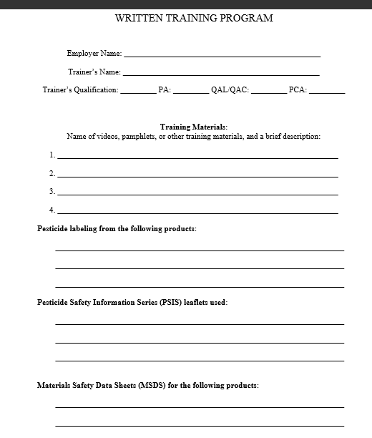
Written Program 3CCR 6724(a)
Notes:
Once you are certified to do the training you are required to have a written training program:
The training program shall describe the materials (e.g., study guides, pamphlets, pesticide product labeling, Pesticide Safety Information Series leaflets, Safety Data Sheets, slides, video tapes) and information that will be provided and used to train his or her employees and identify the person or firm that will provide the training. The training program shall address each of the subjects specified in subsection (b) that is applicable to the specific pesticide handling situation. The employer shall maintain a copy of the training program while in use and for two years after use, at a central location at the workplace.
We will discuss all of the elements that need to be covered in a training on the next slide. The form I am showing here serves as a cover page to your training, it is here that you can list the resources that you use to train your employees. I recommend that you keep of this paperwork in a pesticide compliance binder.

Slide 23
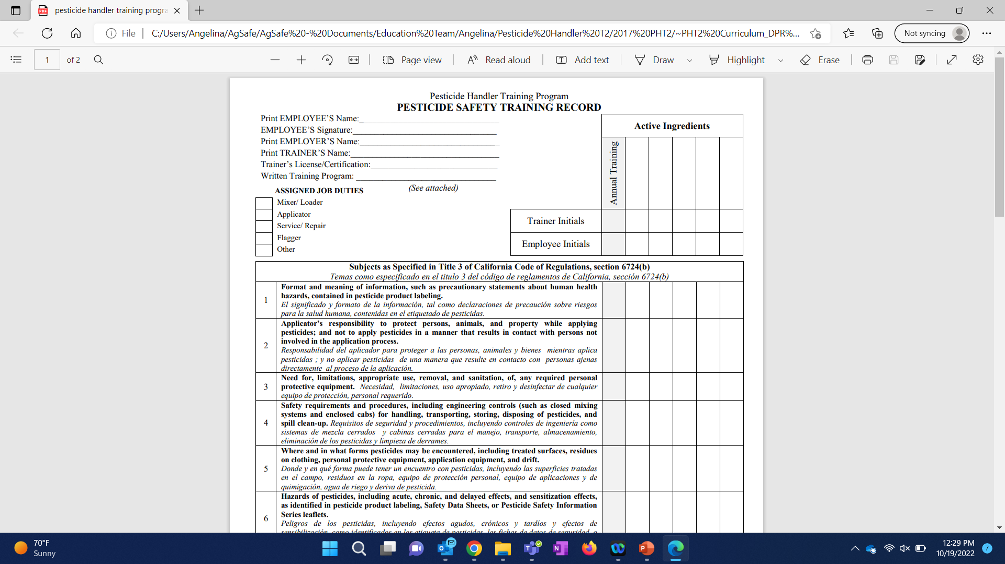
Handler Training
3CCR 3724(b-e)
Notes:
(b) The training shall cover, for each pesticide or chemically similar group of pesticides, to be used:
(1) Format and meaning of information, such as precautionary statements about human health hazards, contained in pesticide product labeling;
(2) Hazards of pesticides, including acute and chronic effects, delayed effects, and sensitization, as identified in pesticide product labeling, Safety Data Sheets, or Pesticide Safety Information Series leaflets;
(3) Routes by which pesticides can enter the body;
(4) Signs and symptoms of overexposure;
(5) Emergency first aid for pesticide overexposure;
(6) How to obtain emergency medical care;
(7) Routine and emergency decontamination procedures, including spill clean up and the need to thoroughly shower with soap and warm water after the exposure period;
(8) Need for, limitations, appropriate use, and sanitation, of, any required personal protective equipment;
(9) Prevention, recognition, and first aid for heat-related illness in accordance with Title 8 of the California Code of Regulations, section 3395;
(10) Safety requirements and procedures, including engineering controls (such as closed systems and enclosed cabs) for handling, transporting, storing, and disposing of pesticides;
(11) Environmental concerns such as drift, runoff, and wildlife hazards;
(12) Warnings about taking pesticides or pesticide containers home;
(13) Requirements of this chapter and chapter 4 relating to pesticide safety, Safety Data Sheets, and Pesticide Safety Information Series leaflets;
(14) The purposes and requirements for medical supervision if organophosphate or carbamate pesticides with the signal word "DANGER" or "WARNING" on the labeling are mixed, loaded, or applied for the commercial or research production of an agricultural plant commodity;
(15) The location of the written Hazard Communication Information For Employees Handling Pesticides (Pesticide Safety Information Series leaflet A-8), other Pesticide Safety Information Series leaflets, and Safety Data Sheets;
(16) The employee's rights, including the right;
(A) To personally receive information about pesticides to which he or she may be exposed;
(B) For his or her physician or employee representative to receive information about pesticides to which he or she may be exposed; and
(C) To be protected against retaliatory action due to the exercise of any of his or her rights.
(c) The training shall be in a manner the employee can understand, be conducted pursuant to the written training program, and include response to questions.
(d) Training shall be completed before the employee is allowed to handle pesticides, continually updated to cover any new pesticides that will be handled, and repeated at least annually thereafter. Initial training may be waived if the employee submits a record showing that training meeting the requirements of this section and covering the pesticides and use situations applicable to the new employment situation was received within the last year. A certified applicator is considered trained for the purposes of this section.
(e) The date and extent of initial and annually required training given to the employee and the job to be assigned shall be recorded. This record shall be verified by the employee's signature and retained by the employer for two years at a central location at the workplace accessible to employees.

Slide 24
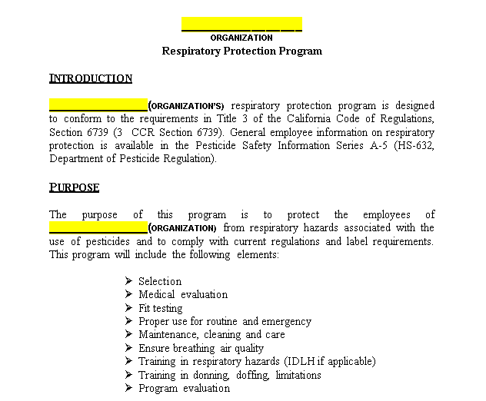
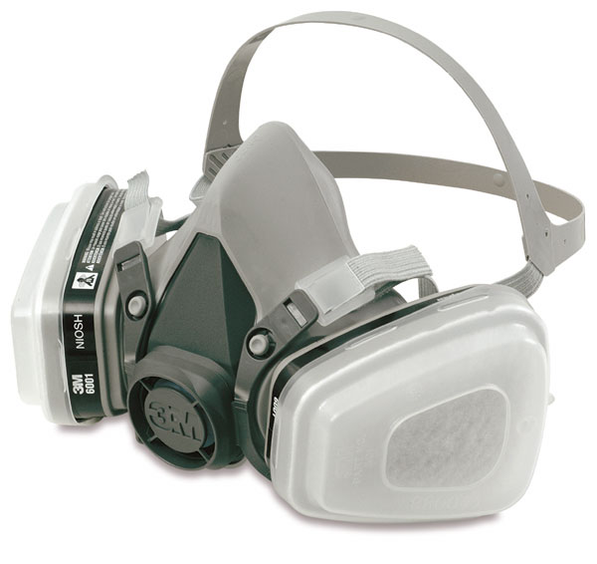
Respiratory Written Program
3CCR 6739(a),(p)
Notes:
(a) General Requirements.
(1) The employer shall assure that:
(A) Employees use approved respiratory equipment in compliance with this regulation when handling pesticides where respirators are required by label, restricted material permit condition, or regulation.
(2) In any workplace where respirators are required by label, restricted material permit condition, regulation, or employer, the employer shall establish a written respiratory protection program with work site-specific procedures. The program shall be updated as necessary to reflect those changes in workplace conditions that affect respirator use. The employer shall include in the program the following provisions, as applicable:
(A) Procedures for selecting respirators for use in the workplace;
(B) Medical evaluations of employees required to use respirators;
(C) Fit testing procedures for tight-fitting respirators;
(D) Procedures for proper use of respirators in routine and reasonably foreseeable emergency situations;
(E) Procedures and schedules for cleaning, disinfecting, storing, inspecting, repairing, discarding, and otherwise maintaining respirators;
(F) Procedures to ensure adequate air quality, quantity, and flow of breathing air for atmosphere-supplying respirators;
(G) Training of employees in the respiratory hazards to which they are potentially exposed during routine and emergency situations, including Immediately Dangerous to Life or Health (IDLH) atmospheres, if appropriate;
(H) Training of employees in the proper use of respirators, including putting on and removing them, any limitations on their use, and their maintenance; and
(I) Procedures for evaluating the effectiveness of the program pursuant to subsections (n)(1) and (2).
1. The respirator program administrator shall administer the respiratory protection program in compliance with this section.
2. The employer shall provide respirators, training, and medical evaluations at no cost to the employee.
(p) Recordkeeping. The employer shall retain written information regarding medical recommendations, fit testing, and the respirator program.
(1) Records required by this section shall be maintained while the employee is required to use respiratory protection and for three years after the end of employment conditions requiring respiratory protection and shall be available for inspection by the employee, the Director, or commissioner.
(2) Fit testing.
(A) The employer shall establish a record of the qualitative and quantitative fit tests administered to an employee including:
1. The name or identification of the employee tested;
2. Type of fit test performed;
3. Specific make, model, style, and size of respirator tested;
4. Date of test; and
5. The pass/fail results for qualitative fit testing or the fit factor and strip chart recording or other recording of the test results for QNFTs.
(3) A written copy of the current respirator program shall be retained by the employer. Previous versions of the written respirator protection program shall be retained for three years.
(4) Written information required to be retained under this subsection shall be made available upon request to employees falling under the respiratory protection program and to the commissioner or persons designated by the Director for review and copying.

Slide 25
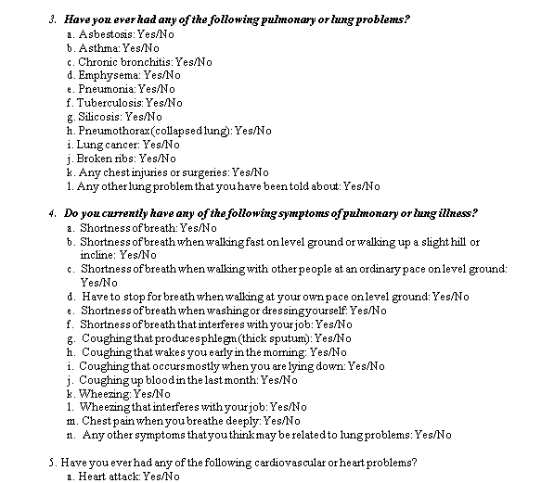

Respiratory Medical Evaluation
3CCR 6739 (d),(s)
Notes:
(d) Medical Evaluation. The employer shall ensure a medical evaluation is conducted to determine the employee’s ability to use a respirator before the employee is fit tested or required to use the respirator in the workplace. The employer may discontinue an employee’s medical evaluations when the employee is no longer required to use a respirator.
(1) Medical Evaluation Procedures.
(A) The employer shall identify a physician or other licensed health care professional (PLHCP) to perform medical evaluations using the medical questionnaire in subsection (q) or an equivalent form or an initial medical examination that obtains the same information as the medical questionnaire.
(B) The medical evaluation shall obtain the information requested by the questionnaire in subsection (q), sections 1 and 2.
(2) Follow-up Medical Examination.
(A) The employer shall ensure that a follow-up medical examination is provided when a PLHCP determines that there is a need for a follow-up medical examination.
(B) The follow-up medical examination shall include any medical tests, consultations, or diagnostic procedures that the PLHCP deems necessary to make a final determination.
(3) Administration of the Medical Questionnaire and Examinations.
(A) The medical questionnaire and examinations shall be administered confidentially during the employee’s normal working hours or
at a time and place convenient to the employee. The medical questionnaire shall be administered in a manner that ensures that the employee understands its content.
(B) The employer shall provide the employee with an opportunity to discuss the questionnaire and examination results with the PLHCP.
(4) Supplemental Information for the PLHCP.
(A) The employer shall provide the following information to the PLHCP before the PLHCP makes a recommendation concerning an employee’s ability to use a respirator:
1. The type and weight of the respirator to be used by the employee;
2. The duration and frequency of respirator use (including use for rescue and escape);
3. The expected physical work effort;
4. Additional protective clothing and equipment to be worn; and
5. Temperature and humidity extremes that may be encountered.
(B) The employer shall not be required to provide any supplemental information provided previously to the PLHCP regarding an employee for a subsequent medical evaluation if the information and the PLHCP remain the same. When the employer replaces a PLHCP, the employer shall ensure that the new PLHCP obtains the information specified in (4)(A)1-5 by having the documents transferred from the former PLHCP to the new PLHCP. Employers are not required to have employees medically reevaluated solely because a new PLHCP has been selected.
(C) The employer shall provide the PLHCP with a copy of the written respiratory protection program and a copy of this section.
(5) Medical Determination.
(A) The employer shall obtain a written medical recommendation from the PLHCP regarding the employee’s ability to use the respirator. The written medical recommendation shall be provided on the form in subsection (s) or provide substantially the same information as follows:
1. Any limitations on respirator use related to the medical condition of the employee, or relating to the workplace conditions in which the respirator will be used, including whether or not the employee is medically able to use the respirator;
2. The need, if any, for follow-up medical evaluations; and
3. A statement that the PLHCP has provided the employee with a copy of the PLHCP’s written medical recommendation.
(B) If a negative pressure respirator is to be used and the PLHCP finds a medical condition that may place the employee’s health at increased risk, the employer shall either provide a powered air purifying respirator (PAPR) provided the PLHCP’s medical evaluation finds that the employee can use such a respirator or make changes in the workplace such that respiratory protection is not required. If a subsequent medical evaluation finds that the employee is medically able to use a negative pressure respirator, then the employer shall no longer be required to provide a PAPR.
(6) Additional Medical Evaluations. The employer shall provide additional medical evaluations that comply with the requirements of this section if:
(A) An employee reports medical signs or symptoms that are related to their ability to use a respirator;
(B) A PLHCP, supervisor, or the respirator program administrator informs the employer that an employee needs to be reevaluated;
(C) Information from the respiratory protection program administrator, including observations made during fit testing and program evaluation, indicates a need for employee reevaluation; or
(D) A change occurs in workplace conditions including, but not limited to, physical work effort, protective clothing, or temperature, that may result in a substantial increase in the physiological burden placed on an employee.
(s) Medical Recommendation Form. A physician or other licensed health care professional’s report of evaluation and approval for respirator use must be on file with the employer before work requiring respirator use is allowed. The following or substantially similar statement from a physician is acceptable:
On ______________________, I evaluated ________________________________.
Date Patient’s name
At this time there (are)/(are not) medical contraindications to the employee named above wearing a respirator while working in potential pesticide exposure environments. The patient (does)/(does not) require further medical evaluation at this time. Any restrictions to wearing a respirator or to the type of respiratory protection are given below.
_____________________________________________________________________________________________________________________________
____________________________________________________________________________________________________________
I have provided the above-named patient with a copy of this form.
______________________________ __________________
Physician Date

Slide 26

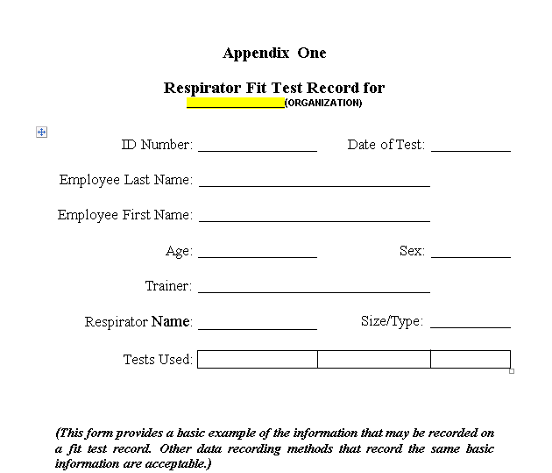
Respiratory Fit Test Records
3CCR (e), (p)
Notes:
(e) Fit Testing. The employer shall assure that employees using a tight-fitting facepiece respirator pass an appropriate qualitative fit test (QLFT) or quantitative fit test (QNFT).
(1) The employer shall ensure that an employee using a tight-fitting facepiece respirator is fit tested before initial use of the respirator, whenever a different respirator facepiece (size, style, model or make) is used, and at least annually thereafter.
(2) The employer shall conduct an additional fit test whenever the employee reports, or the employer, PLHCP, supervisor, or respirator program administrator makes visual observations of changes in the employee’s physical condition that could affect respirator fit. Such conditions include, but are not limited to, facial scarring, dental changes, cosmetic surgery, or an obvious change in body weight.
(3) If after passing a QLFT or QNFT, the employee subsequently notifies the employer, PLHCP, supervisor, or respirator program administrator that the fit of the respirator is unacceptable, the employee shall be given a reasonable opportunity to select a different respirator facepiece and to be retested.
(4) The fit test shall be administered using either the Cal/OSHA-accepted QLFT or QNFT protocols (Title 8, California Code of Regulations, section 5144, Appendix A), or as recommended by the manufacturer of the respirator, if such recommendations are in accordance with Title 8 CCR section 5144, Appendix A, Part II. QLFT is acceptable for all negative-pressure tight-fitting half or full facepiece respirators used in the application of pesticides.
(5) If the fit factor, as determined through a Cal/OSHA-accepted QNFT protocol (Title 8, California Code of Regulations, section 5144, Appendix A), is equal to or greater than 100 for tight-fitting half facepieces, or equal to or greater than 500 for tight-fitting full facepieces, the QNFT has been passed with that respirator.
(6) Fit testing of tight-fitting atmosphere-supplying respirators and tight-fitting powered air-purifying respirators shall be accomplished by performing quantitative or qualitative fit testing in the negative pressure mode, regardless of the mode of operation (negative or positive pressure) that is used for respiratory protection.
(A) Qualitative fit testing of these respirators shall be accomplished by temporarily converting the respirator user’s actual facepiece into a negative pressure respirator with appropriate filters, or by using an identical negative pressure air-purifying respirator facepiece with the same sealing surfaces as a surrogate for the atmosphere-supplying or powered air-purifying respirator facepiece.
(B) Quantitative fit testing of these respirators shall be accomplished by modifying the facepiece to allow sampling inside the facepiece in the breathing zone of the user, midway between the nose and mouth. This requirement shall be accomplished by installing a permanent sampling probe onto a surrogate facepiece, or by using a sampling adapter designed to temporarily provide a means of sampling air from inside the facepiece.
(C) Any modifications to the respirator facepiece for fit testing shall be completely removed, and the facepiece restored to NIOSH-approved configuration, before that facepiece can be used in the workplace.
(p) Recordkeeping. The employer shall retain written information regarding medical recommendations, fit testing, and the respirator program.

Slide 27
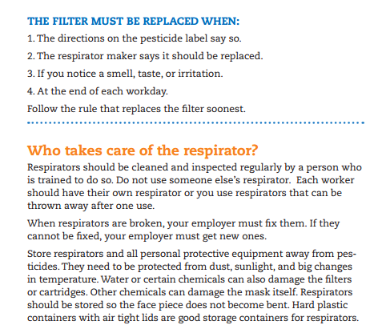
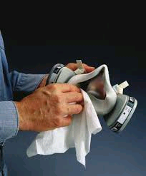
Respirators Inspected
3CCR 6739 (j)(1)
Notes:
(1) The employer shall ensure that all respirators are inspected before each use and during cleaning, and that:
(A) Routine-use respirator inspections include the following:
1. A check of respirator function, tightness of connections, and the condition of the various parts including, but not limited to, the facepiece, head straps, valves, connecting tube, and cartridges, canisters or filters;
2.A check of elastomeric parts for pliability and signs of deterioration; and
3. SCBA air cylinders are checked to ensure that at least one routine use SCBA air cylinder is charged to 80 percent of the manufacturer's recommended pressure level at the beginning of the workday.
(B) Emergency-use or second respirators are checked to ensure that the air cylinders are maintained at 100 percent of manufacturer’s recommended capacity just prior to each use of a pesticide requiring their presence.
(C) Emergency-use respirators are also inspected at least monthly according to the routine-use inspection criteria, manufacturer’s recommendations, and include performance of the following:
1. A check for proper function;
2. A certification that documents the date the inspection was performed, the name (or signature) of the person who made the inspection, the findings, required remedial action, and a serial number or other means of identifying the inspected respirator; and that this information is included on a tag or label that is attached to the storage compartment for the respirator or is kept with the respirator. This information shall be maintained until replaced following a subsequent certification; and
3. A check for properly functioning SCBA regulator and warning devices.
(D) Escape-only respirators must be inspected according to the routine-use inspection criteria, and before being brought into the workplace for use.
(2) The employer shall ensure that respirators that fail an inspection or are otherwise found to be defective shall be removed from service, and discarded, repaired, or adjusted in accordance with the following procedures:
(A) Repairs or adjustments to respirators shall be made only by persons appropriately trained to perform such operations and shall use only the respirator manufacturer’s NIOSH-approved parts designed for the respirator;
(B) Repairs shall be made according to the manufacturer’s recommendations and specifications for the type and extent of repairs to be performed; and
(C) Reducing and admission valves, regulators, and alarms shall be adjusted or repaired only by the manufacturer or a technician trained by the manufacturer.

Slide 28
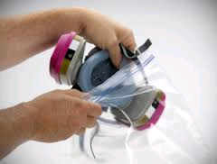
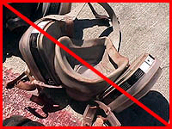
Respirator Storage
3CCr 6739 (h)(4)
Notes:
(4) Respirators are stored to protect them from damage, contamination, dust, sunlight, extreme temperatures, excessive moisture, and damaging chemicals. Respirators shall be packed or stored to prevent deformation of the facepiece and exhalation valve.

Slide 29


Voluntary Use Display
3CCR 6739 (b)(2)
Notes:
(2) If the employer determines that any voluntary respirator use is permissible, the employer shall provide the respirator users with the information contained in subsection (r) and display this information alongside the display of either the Hazard Communication Information for Employees Handling Pesticides in Agricultural Settings (Pesticide Safety Information Series leaflet A-8), or Hazard Communication Information for Employees Handling Pesticides in Noncrop Settings (Pesticide Safety Information Series leaflet N-8), at a central location in the workplace.

Slide 30
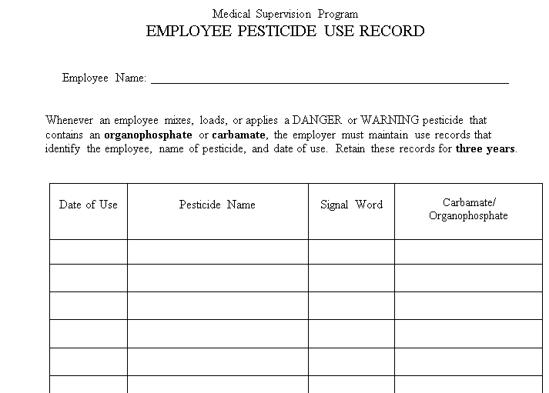
Medical Supervision – Use Records Retained / 3 yrs. 3CCR 6728(a)
Notes:
(a) Whenever an employee mixes, loads, or applies a pesticide with the signal word "DANGER" or "WARNING" that contains an organophosphate or carbamate, for the commercial or research production of an agricultural plant commodity, the employer shall maintain use records that identify the employee, the name of the pesticide, and the date of use. The original or copies of documents otherwise required to be maintained by this chapter may be used to meet the requirements of this Section provided they contain the information required by this Section.

Slide 31
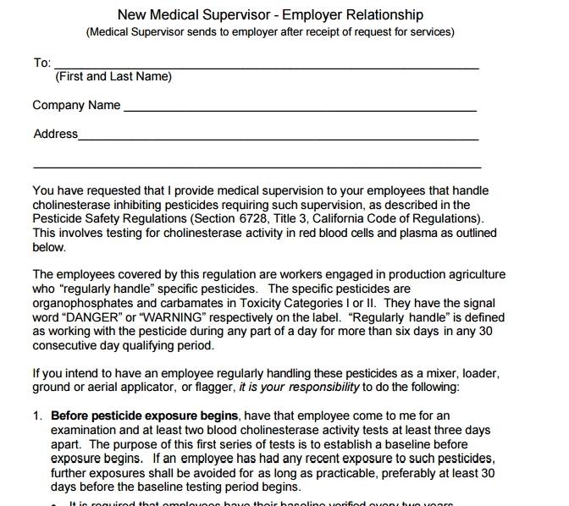
Medical Supervision – Dr. Agreement Available 3CCR 6728(b)
http://oehha.ca.gov/media/downloads/pesticides/document-pesticides/physicianguidelines5thedition2015final.pdf
Notes:
(b) Each employer who has an employee who regularly handles pesticides specified in (a) shall have a written agreement signed by a physician, that includes the names and addresses of both the physician providing the medical supervision and the employer responsible for the employees, stating that the physician has agreed to provide medical supervision and that the physician possesses a copy of, and is aware of the contents of the document "Medical Supervision of Pesticide Workers-Guidelines for Physicians" (available from the Office of Environmental Health Hazard Assessment). A copy of this agreement shall be given to the commissioner by the employer no later than when an employee begins to regularly handle pesticides specified in (a).

Slide 32
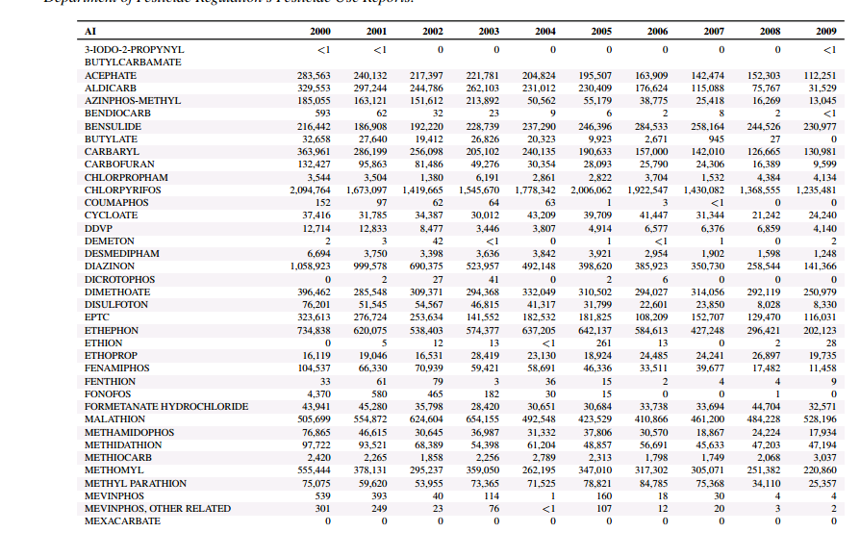
Medical Supervision – Records Retained / 3 yrs. 3CCR 6728(c)
http://www.cdpr.ca.gov/docs/pur/pur09rep/tables/table8.pdf
Notes:
(c) The employer’s responsibilities for medical supervision for employees regularly handling pesticides specified in (a) shall include the following:
(1) All covered employees shall have baseline red cell and plasma cholinesterase determinations. Baseline values shall be verified every two years. For new employees, the medical supervisor may accept previously established baseline values if they are obtained in accordance with these regulations by the same laboratory methodology and are acceptable to the laboratory which will analyze the new employee’s blood samples.
(2)(A) The employer shall ensure that each employee, not previously under medical supervision associated with that employer, has red cell and plasma cholinesterase determinations within three working days after the conclusion of each 30-day period in which pesticides specified in (a) are regularly handled.
(B) After three tests at 30-day intervals, further periodic monitoring shall be at intervals specified in writing by the medical supervisor except for verification of baseline as specified in (1).
(C) Where the medical supervisor has made no written recommendation for continued periodic monitoring, the testing interval shall be 60 days.
(3) The employer shall keep a record of the agreement to provide medical supervision, use records, all recommendations received from the medical supervisor, and all results of cholinesterase tests required to be made on his/her employees by this Section or by the medical supervisor. Records required by this Section shall be maintained for three years and shall be available for inspection by the employee, the Director, commissioner, county health official, or state health official.
(4) The employer shall follow the recommendations of the medical supervisor concerning matters of occupational health.
(5) The employer shall post the name, address, and telephone number of the medical supervisor in a prominent place at the locale where the employee usually starts the workday; or if there is no locale where the employee usually starts the workday, at each worksite; or in each work vehicle.

Slide 33

Medical Supervision – Medical Sup. Posting 3CCR 6728(c)(5)
Name
Address
Telephone Number
Notes:
(5) The employer shall post the name, address, and telephone number of the medical supervisor in a prominent place at the locale where the employee usually starts the workday; or if there is no locale where the employee usually starts the workday, at each worksite; or in each work vehicle.

Slide 34
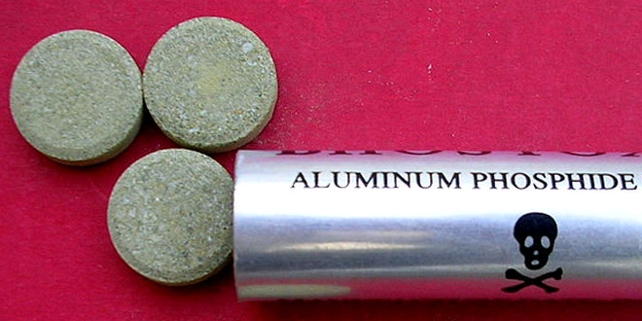
Pesticide Storage – Possession Permit for Storage 3CCR 6412
Must have a restricted materials permit to store restricted material
May be an issue if you switch to an OP-Id and still have restricted materials in your storage shed
Notes:
(a) Except as provided in this Section and Sections 6400, 6414 and 6416, restricted materials shall be possessed or used only under permit of the commissioner or under his direct supervision, or under permit of the director in any county in which there is no commissioner.
(b) The person named in a restricted material permit is authorized to retain possession, except for sale, of materials for which the permit was valid after such permit expires, provided they are stored in accordance with Sections 6670 and 6672.

Slide 35

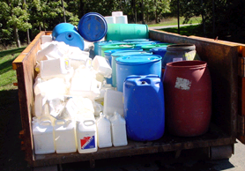
Pesticide Storage – Containers Secured 3CCR 6672(b)
Notes:
(b) Each person who controls the use of any property or premises is responsible for all containers or equipment on the property that hold, or have held, a pesticide. Unless all such containers are under his personal control so as to avoid contact by unauthorized persons, he shall:
(1) Provide a person responsible to him to maintain such control over the containers at all times; or
(2) Store all such containers in a locked enclosure, or in the case of liquid pesticides in a container larger than 55 gallons in capacity, the container shall have a locked closure. Either shall be adequate to prevent unauthorized persons from gaining access to any of the material.

Slide 36
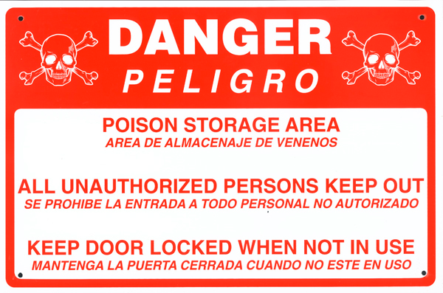
Storage Posted, “Warning/Danger” 3CCR 6674
Notes:
Signs visible from any direction of probable approach shall be posted around all storage areas where containers that hold, or have held, pesticides required to be labeled with the signal words "warning" or "danger" are stored. Each sign shall be of such size that it is readable at a distance of 25 feet and be substantially as follows:
DANGER
POISON STORAGE AREA
ALL UNAUTHORIZED PERSONS KEEP OUT
KEEP DOOR LOCKED WHEN NOT IN USE
The notice shall be repeated in an appropriate language other than English when it may reasonably be anticipated that persons who do not understand the English language will come to the enclosure.

Slide 37
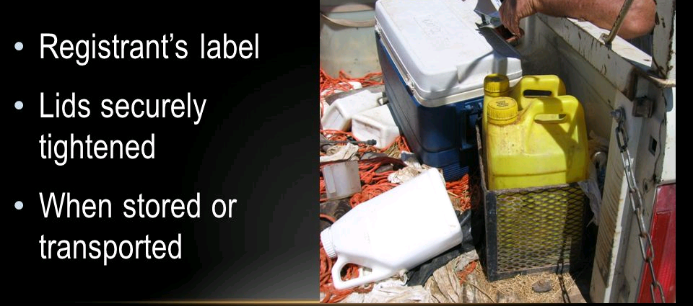
Containers Labeled / Closure
3CCR 6676
Notes:
Except as provided in the Food and Agricultural Code pertaining to service containers, any container that holds, or has held, any pesticide, when stored or transported, shall carry the registrant's label. All lids or closures shall be securely tightened except when the procedure described in Section 6684 has been followed. This Section shall not apply to measuring devices that are not used to store or transport a pesticide.

Slide 38
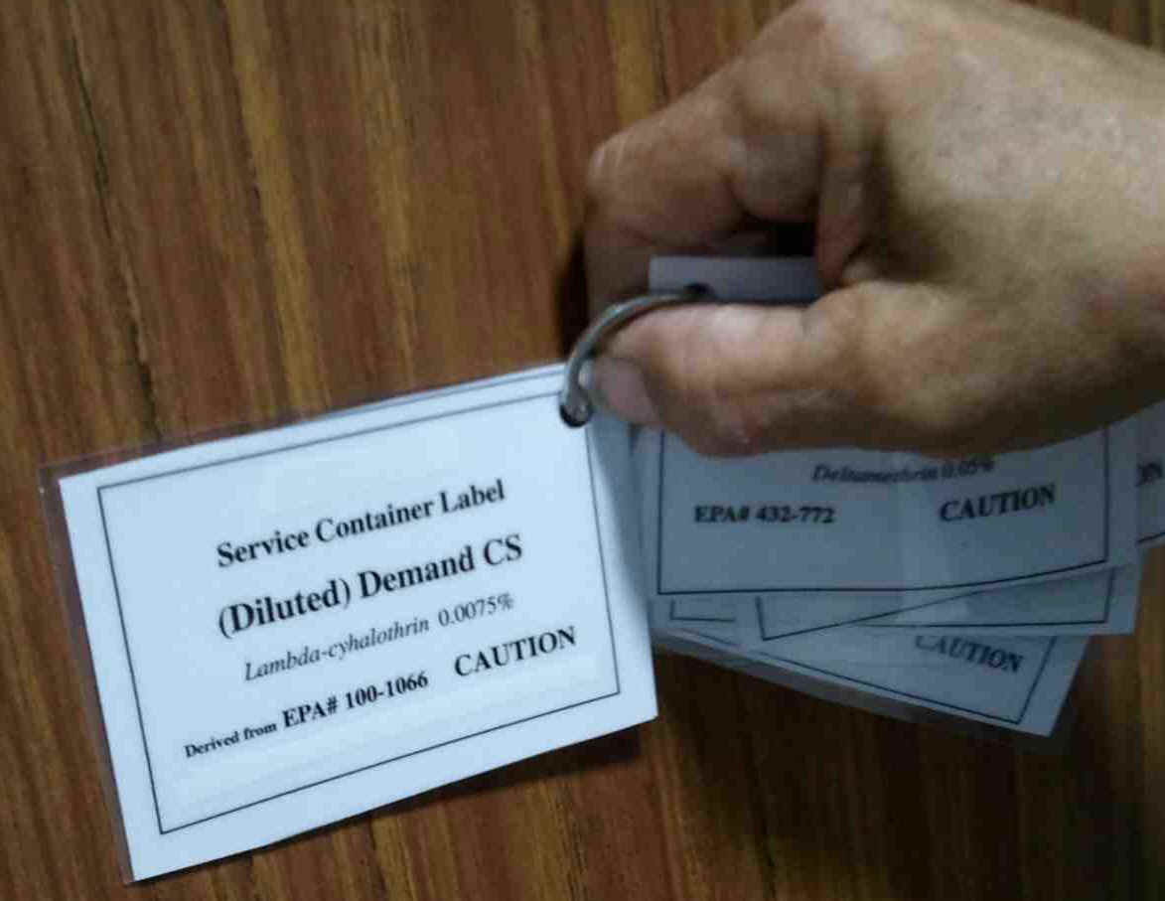
Service Container Labeling
3CCR 6678
d
Notes:
What is a service container?
It is a container, other than the original labeled container of a registered pesticide provided by the registrant, that is utilized to hold, store, or transport the pesticide or the use-dilution of the pesticide.
It mush be labeled with:
(a) The name and address of the person or firm responsible for the container;
(b) The identity of the pesticide in the container; and
(c) The word "Danger," "Warning," or "Caution," in accordance with the label on the original container.
Like the picture I have shown here, I would see growers and PCBs have these types of laminated tags on their service containers.
Service containers, other than those used by a person engaged in the business of farming when the containers are used on the property the person is farming, shall be labeled with:
(a) The name and address of the person or firm responsible for the container;
(b) The identity of the pesticide in the container; and
(c) The word "Danger," "Warning," or "Caution," in accordance with the label on the original container.

Slide 39
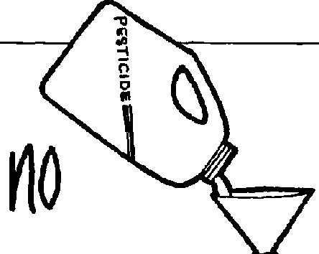

Proper Containers
3CCR 6680
In no case shall a pesticide be placed or kept in any container of a type commonly used for food, drink or household products.
Notes:
Read the slide. Uncle Art 4840 in coffee can
This is practically dangerous around kids.
I lost count of the number of investigations that I did where someone would put pesticide into a water bottle and then someone, not knowing, would take a gulp, and then end up at the hospital.
Just as a side note, whenever someone sees a doctor due to a pesticide illness of exposure the dr. is required by law to report it to the local ag comm office. In turn, the ag comm office must conduct an investigation.

Slide 40
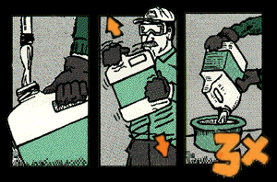
Container Properly Rinsed
3CCR 6684
Notes:
Partially fill container with water, shake, empty into spray tank. Repeat this process 2 more times for a total of 3.
Remember, you are supposed to do this after mixing, the rinsing solution is supposed to be poured into your spray tank.
(a) Except for containers to be returned to the registrant, each emptied container that has held less than 28 gallons of a liquid pesticide that is diluted for use shall be rinsed and drained by the user at time of use as follows:
(b)(1) Use the following amount of water or other designated spray carrier for each rinse.
Size of container
Amount of rinse medium
Less than 5 gallons 1/4 container volume
5 gallons or over 1/5 container volume
(2) Place required minimum amount of rinse medium in the container, replace closure securely, and agitate.
(3) Drain rinse solution from container into tank mix. Allow container to drain 30 seconds after normal emptying.
(4) Repeat (2) and (3) above a minimum of two times so as to provide a total of three rinses; or
(c)(1) Invert the emptied container over a nozzle located in the opening of the mix tank which is capable of rinsing all inner surfaces of the container.
(2) Activate the rinse nozzle allowing the rinse solution to drain into the tank. The rinse shall continue until the rinse solution appears clear and a minimum of one-half of the container volume of rinse medium has been used. A minimum of 15 pounds pressure per square inch shall be used for rinsing; or
(d) Other rinse methods, at least equal in effectiveness to the above, approved by the director.

Slide 41
For more information contact us
  http://www.agsafe.org
  209-526-4400

